Slide 1

Team5
Project 2
Pandemic
Propagation
Vaishall Pradeepkumar
Youssef Mroue
Eliana Suarez
Xiaodi Lin
02.27.2020

Slide 2
Background:
The coronavirus that originated in China has spread fear and anxiety around the world in every corner since New Year 2020. This deadly virus pandemic again caused by human who desperate against nature law. Our perspective of analysis is raising the awareness in public and helping people who are interest in this study.
Data:
Coronavirus: https://github.com/CSSEGISandData/COVID-19/
SARS: https://www.who.int/csr/sars/country/table/en/
H1N1: https://www.kaggle.com/de5d5fe61fcaa6ad7a66/pandemic-2009-h1n1-swine-flu-influenza-a-dataset
Geographic: https://cdn.jsdelivr.net/npm/world-atlas@2/countries-110m.json
Analysis:
For better showing the lessons we learned from our history, we added other respiratory viruses in our analysis. Our horizontal comparison analysis demonstrate those similar viruses spread paten over time.

Slide 3


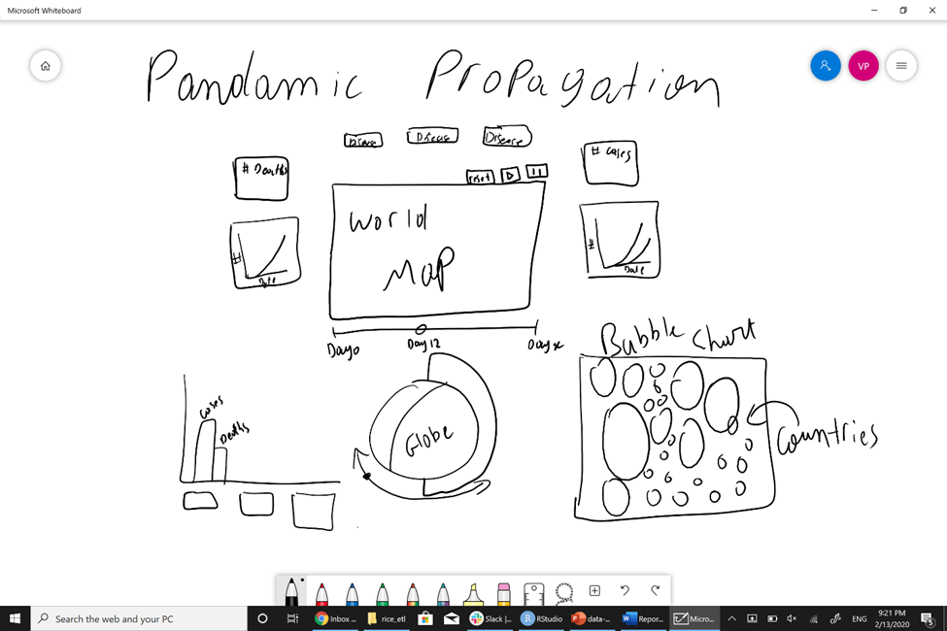
Project Design:

Slide 4

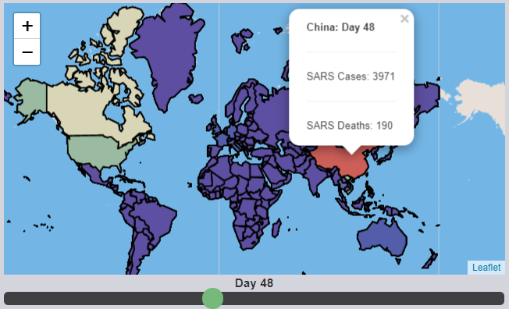
Close look of each part on the project
Map
Map is one of the best tool for visualizing the density of viruses spreading over the world with the color scale.

Slide 5
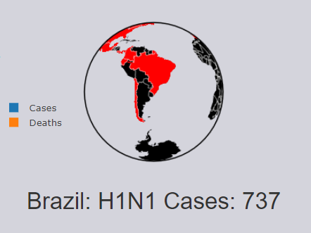
The dynamic globe demonstrates a model that how viruses spread without border from one region to another violently and globally
Globe

Slide 6
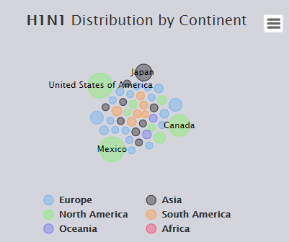
Bubble plot is another attractive way for demonstrating analysis data.
The specialty in this plot is using a switch button to control the display in different emphasizes.
Here one emphasize on different viruses, another is showing the data in different continents.

Slide 7
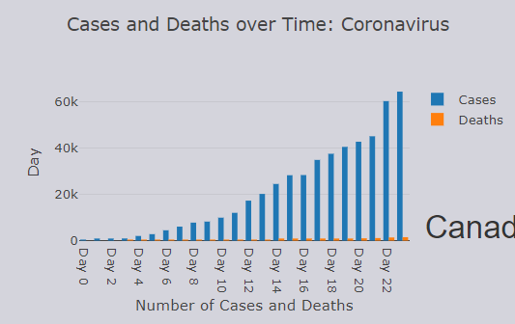
Our bar chart will display the analysis result on individual viruses affects over time.
This vertical analysis is comparing the cases between diagnostic confirmed and clinically death.

Slide 8
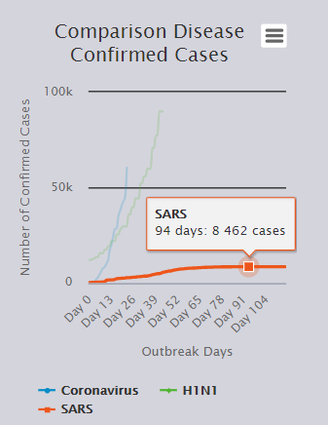
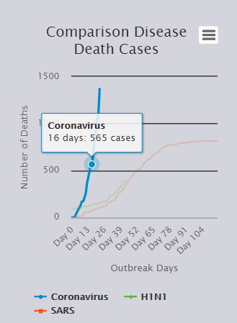
We use classical line chart for its intuitive demonstration ability. As you checking, you will find the line chart is easily to see different pattern that those 3 viruses formed.
The line chart analysis revealing the more current virus pandemic, the more live threatening.

Slide 9
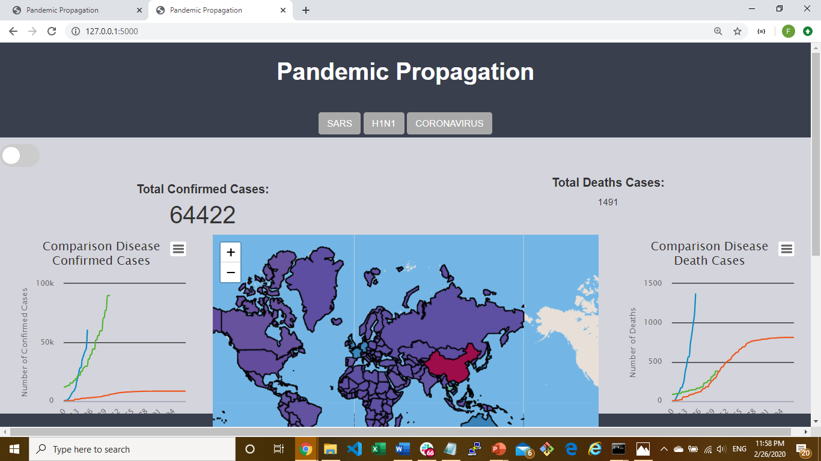

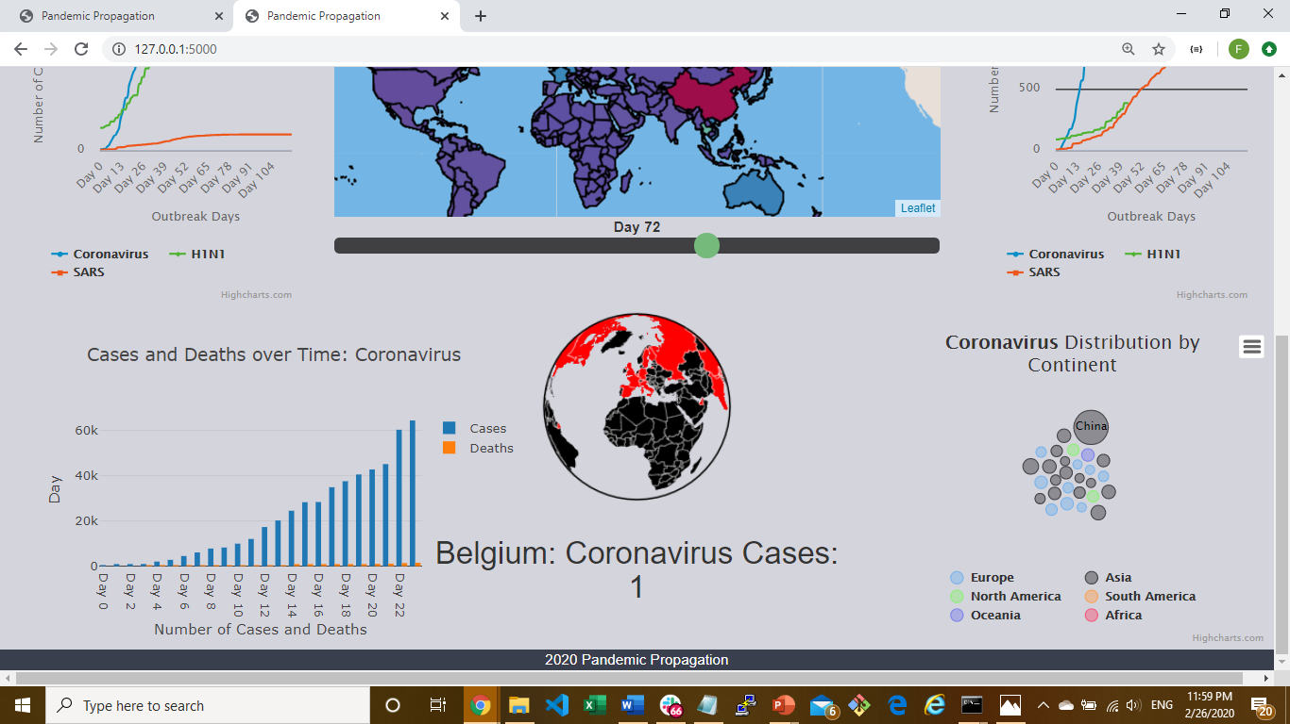

Slide 10
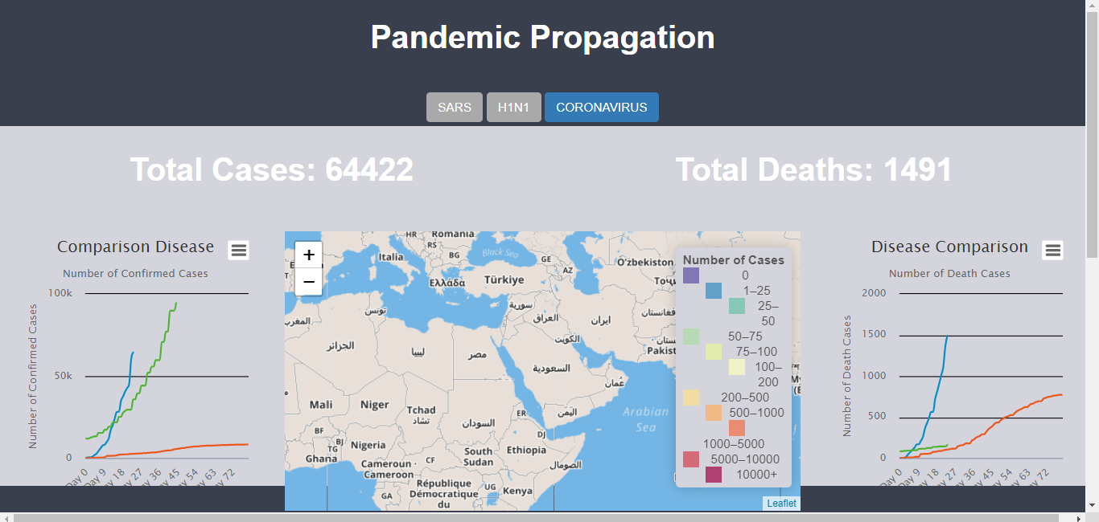
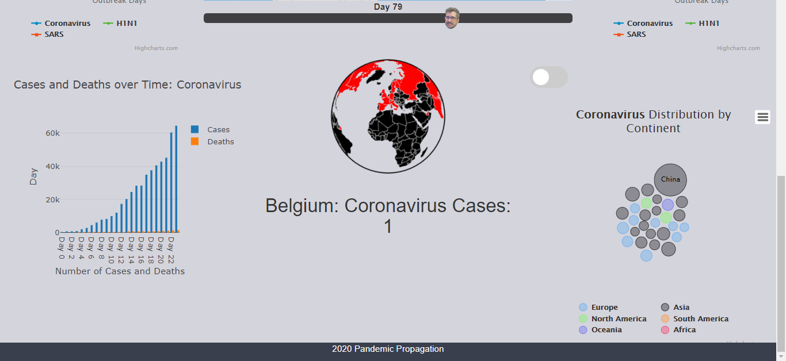

Slide 11
Conclusion:
For those deadly viruses spread globally, our analysis focused on the world effects and horizontal comparison.
The analysis outcome showing every time the virus's outbreak, it’s power became more inexorable and more difficult to control for human
From the bloody lesion, we learned that all lives living in the same space. We, human need to know to respect nature rule. Protect nature is protect ourselves, killing nature is killing ourselves.

Slide 12
Credit:
Project Idea: Eliana
Data Resources: Eliana, Youssef, Vaishall
Design: All
Flask: Vaishall
HTML, Style, Line Chart: Eliana
Map, Globe: Vaishall
Bubble Plot, Bar Chart: Youssef
Presentation: Xiaodi
Special Acknowledgement:
Control: Vaishall

